Slide 1

8-Puzzle Problem
Artificial Intelligence
Instructor: M Zeeshan Aslam
Email: zeeshan.aslam@case.edu.pk

Slide 2
Outlines
What is 8-Puzzle problem?
Solve 8-Puzzle problem using BFS.
Solve 8-Puzzle problem using A* Search.

Slide 3
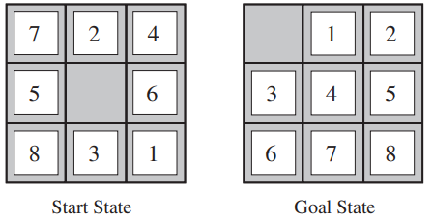
8-Puzzle
The 8-puzzle, an instance of which is shown in below Figure, consists of a 3×3 board with eight numbered tiles and a blank space.
A tile adjacent to the blank space can slide into the space.
The object is to reach a specified goal state, such as the one shown on the right of the figure.

Slide 4
8-Puzzle
The standard formulation is as follows:
States: A state description specifies the location of each of the eight tiles and the blank in one of the nine squares.
Initial state: Any state can be designated as the initial state. Note that any given goal can be reached from exactly half of the possible initial states.
Actions: The simplest formulation defines the actions as movements of the blank space Left, Right, Up, or Down. Different subsets of these are possible depending on where the blank is.

Slide 5
8-Puzzle
Transition model: Given a state and action, this returns the resulting state; for example, if we apply Left to the start state in previous Figure, the resulting state has the 5 and the blank switched.
Goal test: This checks whether the state matches the goal configuration shown in previous Figure. (Other goal configurations are possible.)
Path cost: Each step costs 1, so the path cost is the number of steps in the path.

Slide 6
8-Puzzle
The 8-puzzle belongs to the family of sliding-block puzzles, which are often used as SLIDING-BLOCK PUZZLES test problems for new search algorithms in AI.
This family is known to be NP-complete, so one does not expect to find methods significantly better in the worst case than the search algorithms.
The 8-puzzle has 9!/2 = 181, 440 reachable states and is easily solved.
The 15-puzzle (on a 4×4 board) has around 1.3 trillion states, and random instances can be solved optimally in a few milliseconds by the best search algorithms.
The 24-puzzle (on a 5 × 5 board) has around 1025 states, and random instances take several hours to solve optimally.

Slide 7
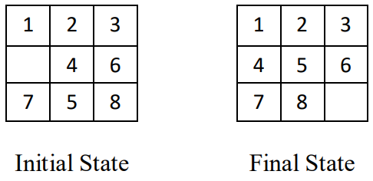
8-Puzzle Problem with Breadth First Search

Slide 8
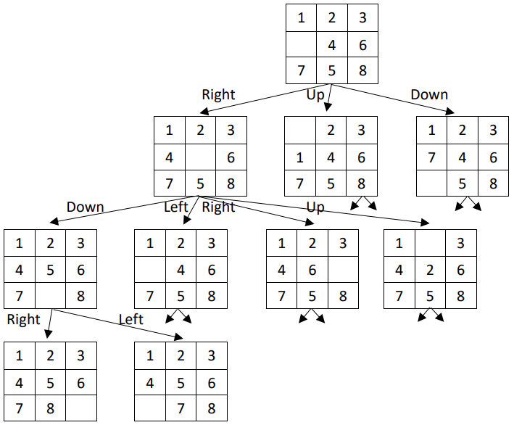
8-Puzzle Problem with Breadth First Search
Initial State
Final State

Slide 9
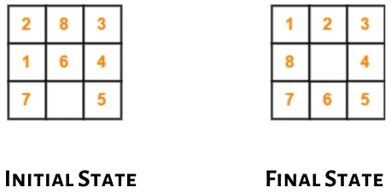
8-Puzzle Problem with A* Search
Search the misplaced tiles.
Find Heuristic value through misplaced tiles count.
Expand further only those that have less value of heuristic.

Slide 10
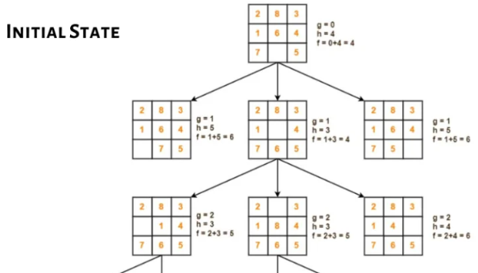
8-Puzzle Problem with A* Search

Slide 11
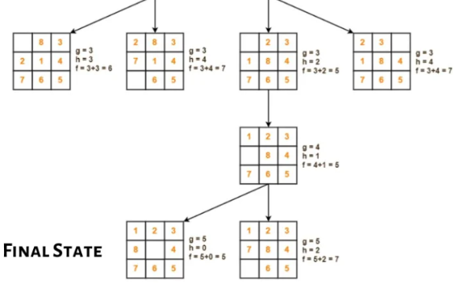
8-Puzzle Problem with A* Search

